Slide 1


Smart Apply 📋
AI Agents Hackathon Submission
AI Agents

Slide 2



About the Team!

Slide 3




Our Project
Smart Apply uses LLM AI Agents and Web Scraping to simplify the process of crafting personalized resumes tailored to individual skills, experiences, and career goals!
We utilized:
Langchain
CAMEL AGI

Slide 4
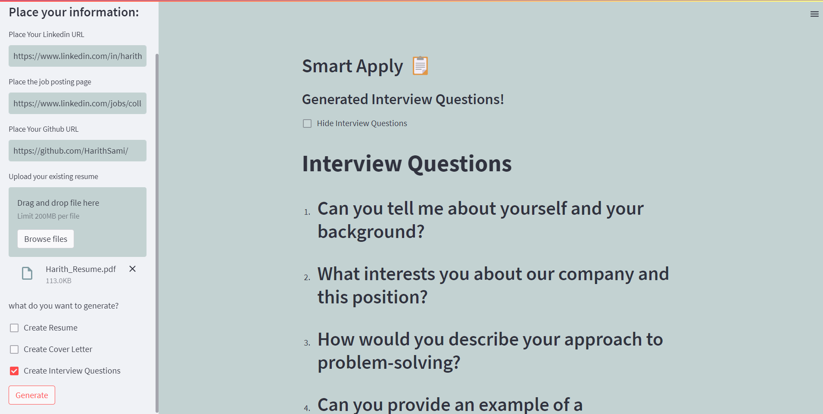
Design Layout

Slide 5
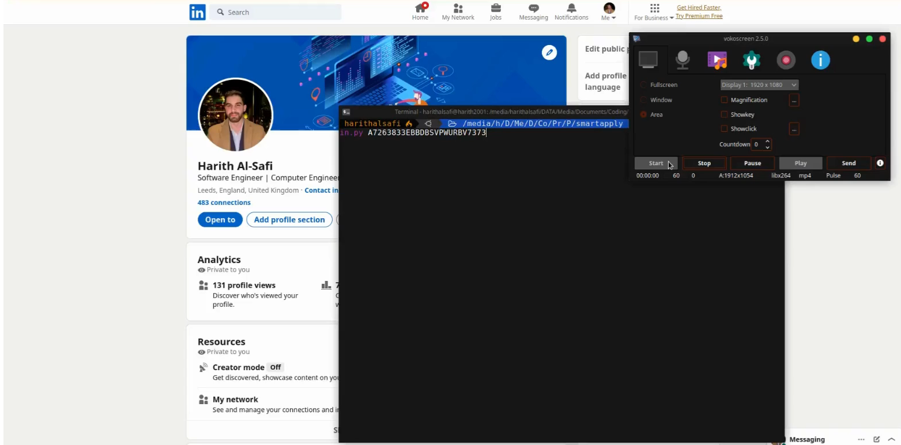
Video Demo

Slide 6

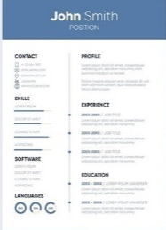

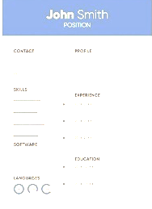

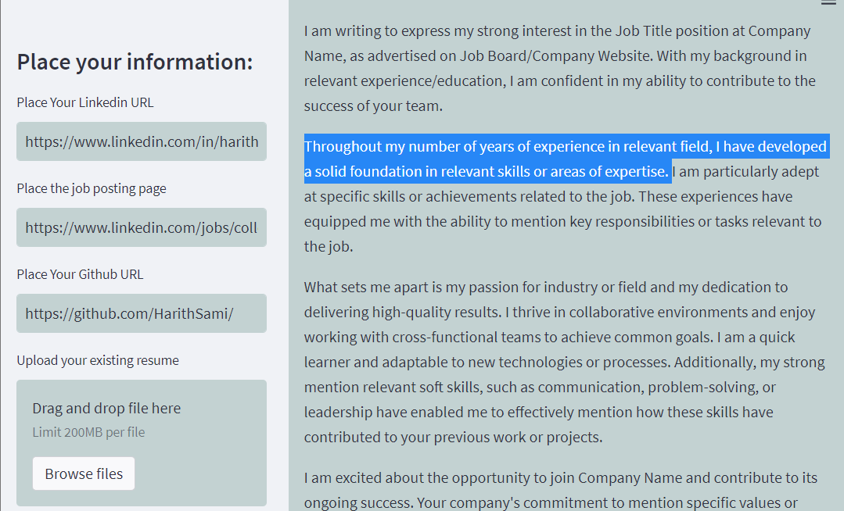
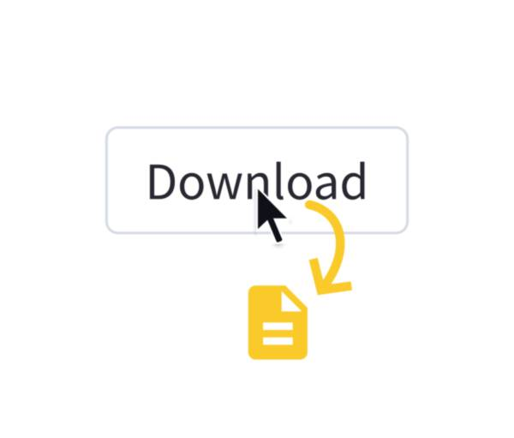
How to use:
1
Input LinkedIn and Job Posting Links.
Select Desired Resume Elements.
Select your preferred style
Preview and Edit.
Export and Share.
1
2
3
2
3
4
5
4
4

Slide 7
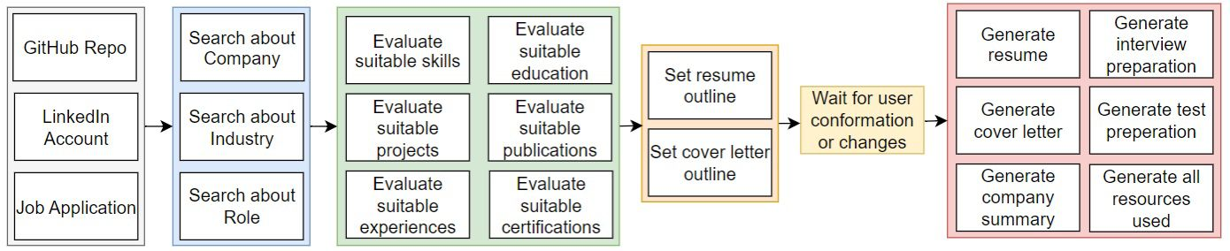
Backend Project Layout
1
Our software incorporates a seamless process that begins with user input.
2
Once the necessary information is filled, our system utilizes web scraping to extract data regarding the user's job experience and desired position.
1
2

Slide 8
Backend Project Layout
3
This data is then reformatted to ensure optimal processing by our AI agents. We employ three AI agents in this process:
One to identify matches between the user's experience and required job qualifications.
Another to analyze company backgrounds and orientations.
A third to review the user's portfolio.
4
Subsequently, all this text data is passed to the final agent, which generates a customized resume by leveraging the collected information.
3
4

Slide 9
Backend Project Layout
5
This data is then reformatted to ensure optimal processing by our AI agents. We employ three AI agents in this process:
One to identify matches between the user's experience and required job qualifications.
Another to analyze company backgrounds and orientations.
A third to review the user's portfolio.
6
The resulting resume is meticulously formatted using HTML and CSS, resulting in a visually appealing document that can be downloaded as a PDF. This same process is also utilized for generating cover letters and interview questions, all handled by the final agent.
6
5

Slide 10
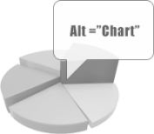
Scalability Features
All charts also need to have alt text. To add alt text to a chart, right click on the chart and select Format Chart Area which will open the Format Chart Area pane, then go to Size & Properties > Alt Text and enter your alt text only into the Description field.
Alt text examples for two different chart types on this slide:
1
Line chart showing values of three series for four categories
2
Clustered column chart showing values of three series for four categories
1
2
Learn more about adding alt text to charts

Slide 11
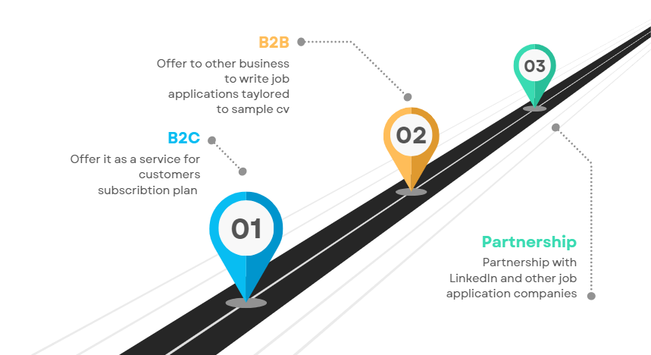
Monetization Scalability Plan

Slide 12
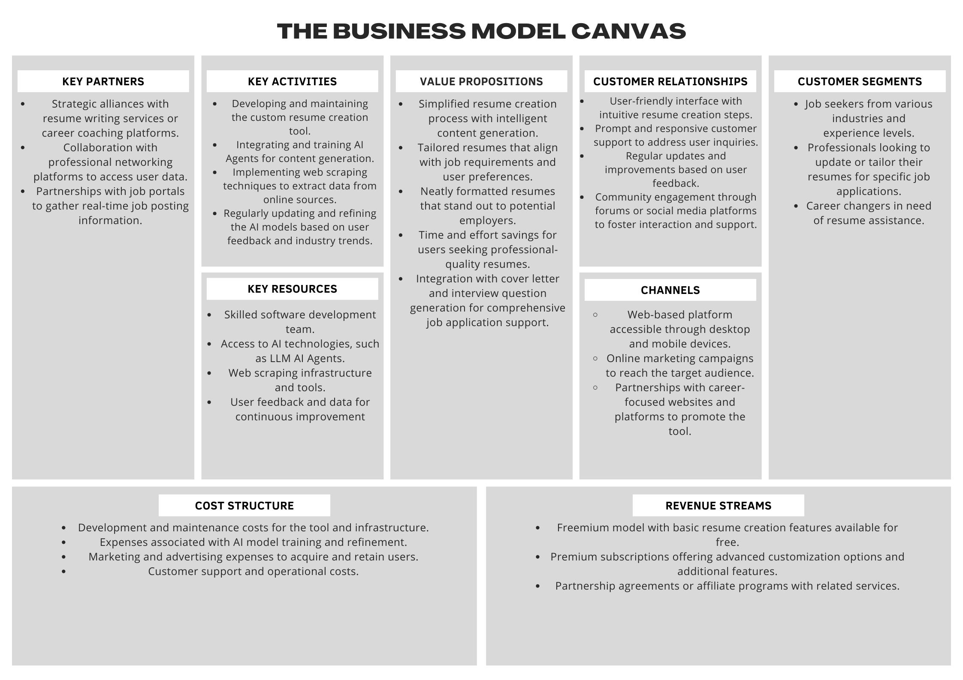

Slide 13



Learn More
More questions about Accessibility?
Visit the repository page here
→
github.com/harith-alsafi/smartapply

